Slide 1
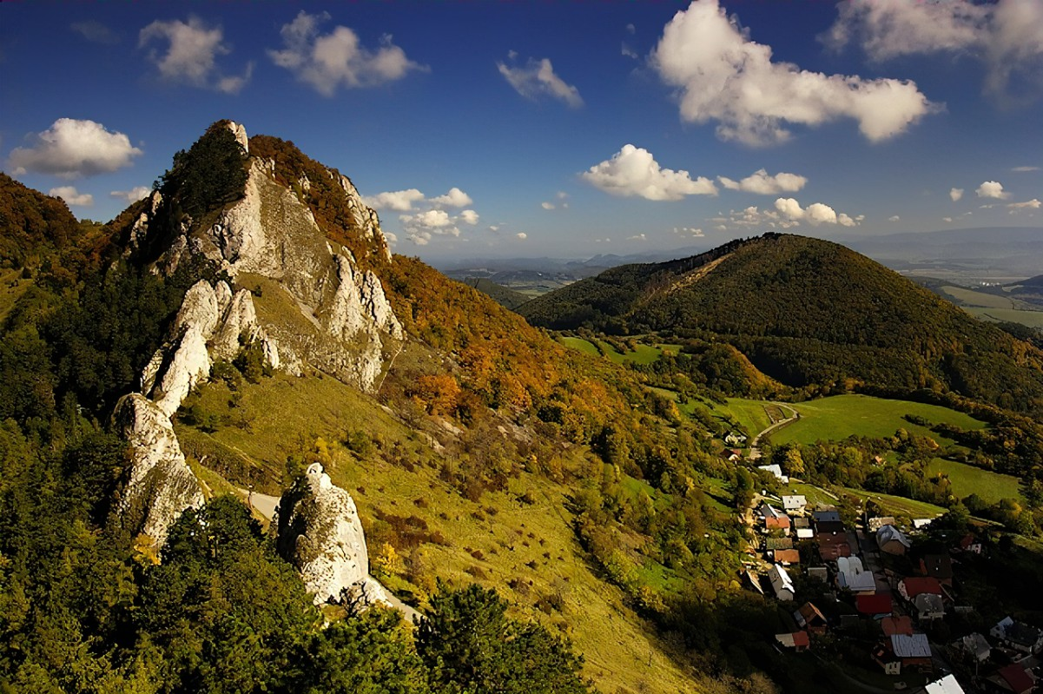
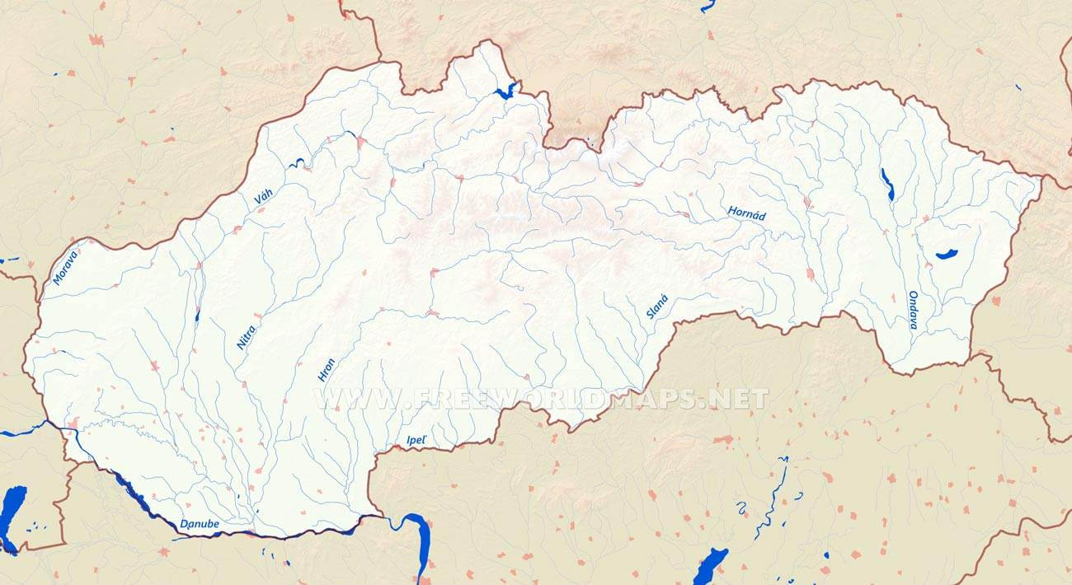
Čo to znamená ?
What does it mean?5
Geografické a prírodné prostredía – Geographical and natural environment
Je to veda, ktorá študuje priestorové rozloženie javov na Zemi (presnejšie časť Zeme nazývaná "krajinná sféra"), ich vzájomnú interakciu a vývoj v čase.
It is a science that studies the spatial distribution of phenomena on Earth (more precisely, parts of Earth known as the "land sphere"), their mutual interactions, and their development over time.
Urobili:RADO KMETO, DARIUS CONEARIC, ANDREEA POLACEC, MATEI – RAREȘ FAUR, DAMIAN SEDLACEK, KAROLINA KESSNEROVA

Slide 2
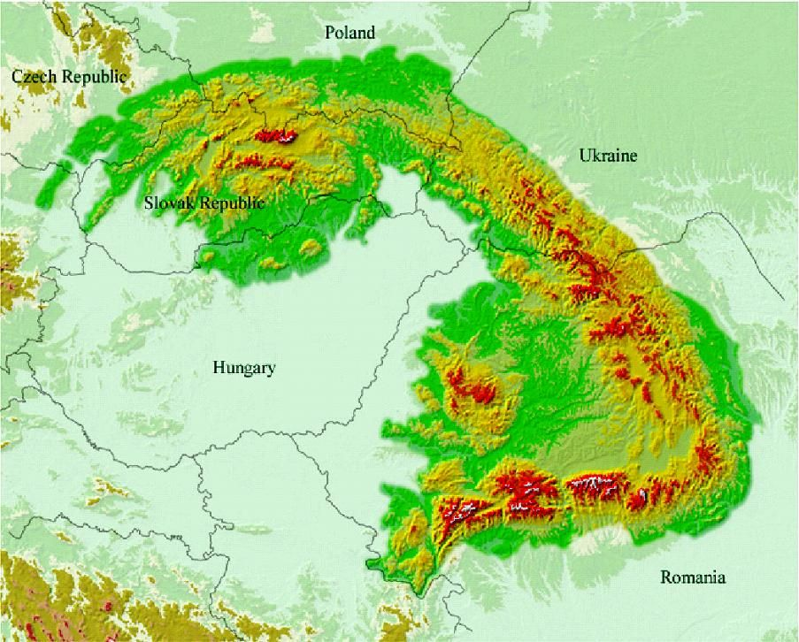
Urobili:RADO KMETO, DARIUS CONEARIC, ANDREEA POLACEC, MATEI – RAREȘ FAUR, DAMIAN SEDLACEK, KAROLINA KESSNEROVA
Čo to znamená ?
Čo to znamená ?
What does it mean?
Geografické a prírodné prostredía – Geographical and natural environment
Je to veda, ktorá študuje priestorové rozloženie javov na Zemi (presnejšie časť Zeme nazývaná "krajinná sféra"), ich vzájomnú interakciu a vývoj v čase.
It is a science that studies the spatial distribution of phenomena on Earth (more precisely, parts of Earth known as the "land sphere"), their mutual interactions, and their development over time.

Slide 3
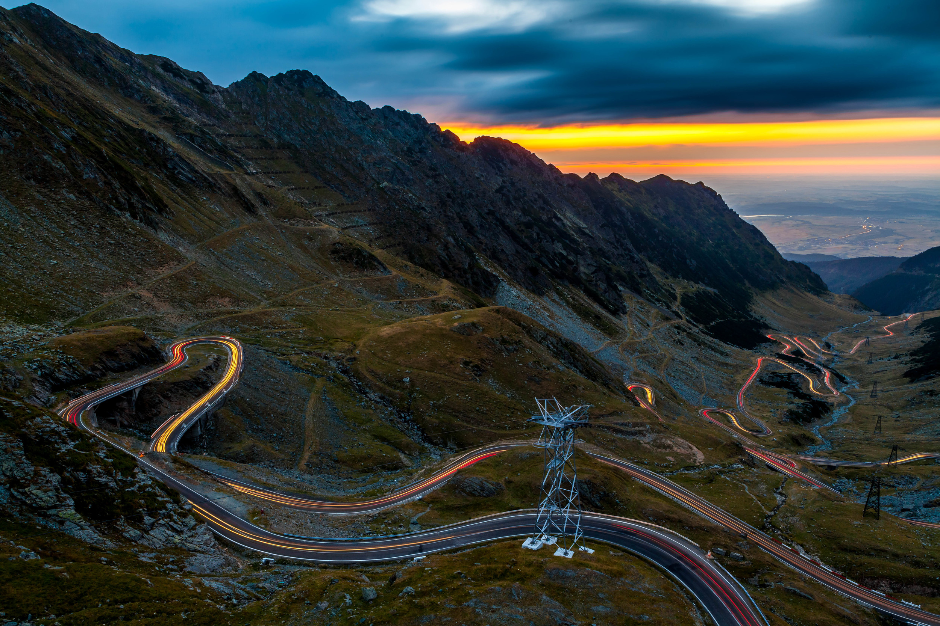
S čoho su zložene?
Mapa Karpatoch, ktoré sa nachádzajú v Rumunsku, Slovensku, Maďarsku... – The Carpatic map which is in:Romania,Slovakia, Hungary...
What does it mean?
Čo to znamená ? – What does it mean?
Vonkajšie pásmo je tvorené z flyšových príkrovov, centrálne pásmo hlbinnými vyvreninami a vápencami, vnútorné povrchovými vyvreninami, pozostatky treťohorného vulkanizmu
The external zone is formed by flysch covers, the central zone by deep-seated intrusions and limestones, and the internal zone by surface intrusions and remnants of Tertiary volcanism.
Je veda ktora študuje priestorové rozšíreníe jevů na Zemi (přesněji části Země, nazývané „krajinná sféra“), jejich vzájemnou interakci a vývoj v čase. -

Slide 4
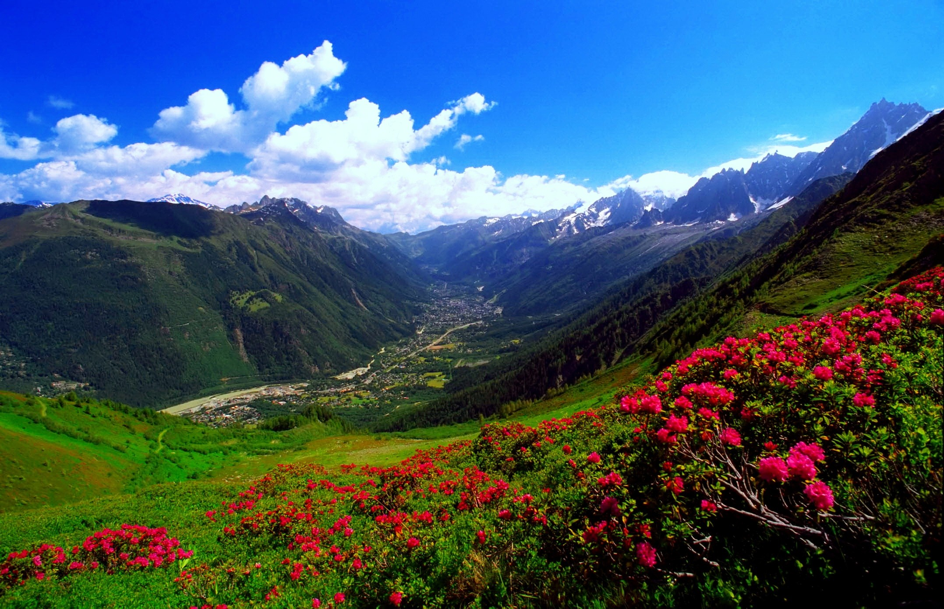
Slovenské Karpaty
Vel´ké karpaty
Malé karpaty
Biele karpaty
Rumunské Karpaty
Carpații Occidentali
Carpații Orientali
Carpații Meridionali
What does it mean?
Podla toho ako sa delia?
How are they grouped?
How are they grouped?
S čoho su zložene?
What are they made of?
Podla toho ako sa ďelia?
It is a science that studies the spatial distribution of phenomena on Earth (more precisely, parts of Earth known as the "land sphere"), their mutual interactions, and their development over time.
Vonkajšie pásmo je tvorené z flyšových príkrovov, centrálne pásmo hlbinnými vyvreninami a vápencami, vnútorné povrchovými vyvreninami, pozostatky treťohorného vulkanizmu
The external zone is formed of flysch covers, the central zone of deep-seated intrusions and limestones, and the internal zone of surface intrusions and remnants of Tertiary volcanism.
Rumunské Karpaty
Carpații Occidentali
Carpații Orientali
Carpații Meridionali
Rumunské Karpaty
Carpații Occidentali
Carpații Orientali
Carpații Meridionali
Slovenské Karpaty
Velke karpaty
Male karpaty
Biele karpaty

Slide 5
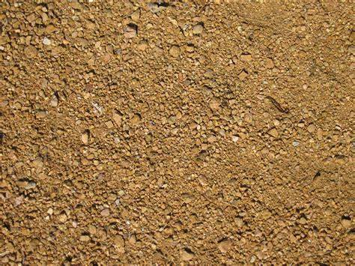
Vlastnosti pôdy sú výsledkom procesov tvorby pôdy na pozadí určitého podložia, podnebia a pôsobenia organizmov. Horná vrstva pôdy je najviac ovplyvnená účinkami vegetácie.
Proprieties
Podla toho ako sa delia?
How are they grouped?
Slovenské Karpaty
Vel´ké karpaty
Malé karpaty
Biele karpaty
Rumunské Karpaty
Carpații Occidentali
Carpații Orientali
Carpații Meridionali
Soil properties are the result of soil formation processes against a backdrop of specific parent material, climate, and the influence of organisms. The upper layer of soil is most affected by the effects of vegetation.
Vlastnosti pôdy sú výsledkom procesov tvorby pôdy na pozadí určitého podložia, podnebia a pôsobenia organizmov. Horná vrstva pôdy je najviac ovplyvnená účinkami vegetácie.

Slide 6
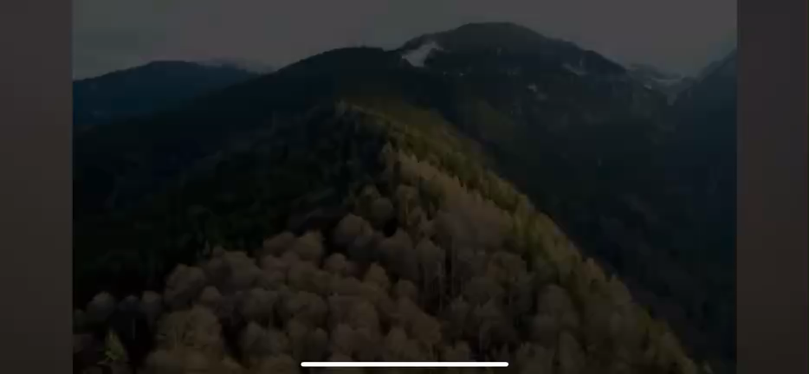

Slide 7
Podla toho ako sa ďelia?
How are they grouped?
Vlastnosti
Proprieties
Vlastnosti pôdy sú výsledkom procesov tvorby pôdy na pozadí určitého podložia, podnebia a pôsobenia organizmov. Horná vrstva pôdy je najviac ovplyvnená účinkami vegetácie.
The soil properties are the result of the soil formation processes against a backdrop of specific subsoil material, climate, and the influence of organisms. The upper layer of the soil is mostly affected by the effects of vegetation.
Slovenské Karpaty
Velke karpaty
Male karpaty
Biele karpaty
Rumunské Karpaty
Carpații Occidentali
Carpații Orientali
Carpații Meridionali

Slide 8
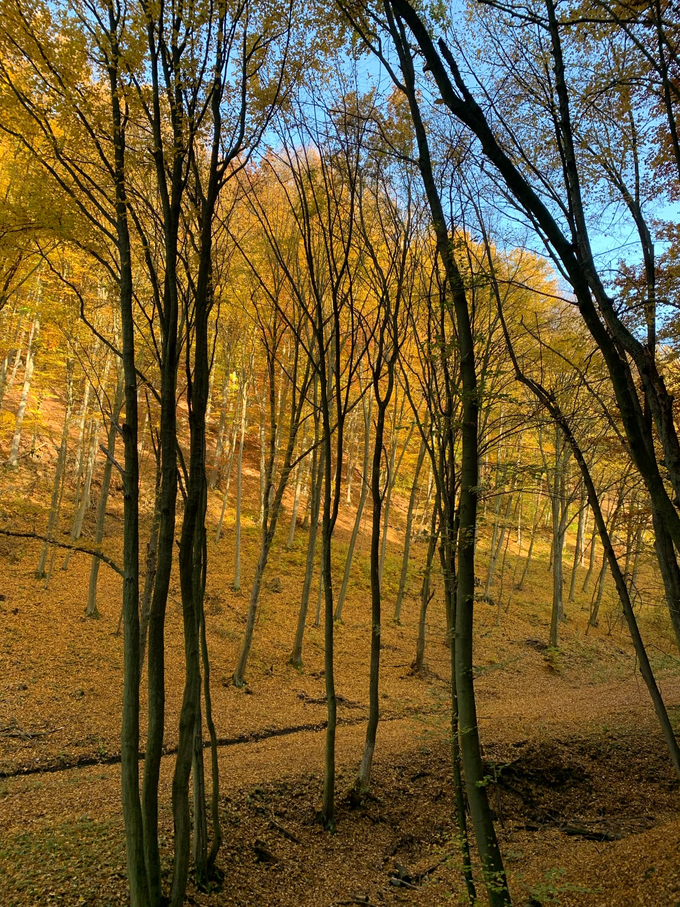
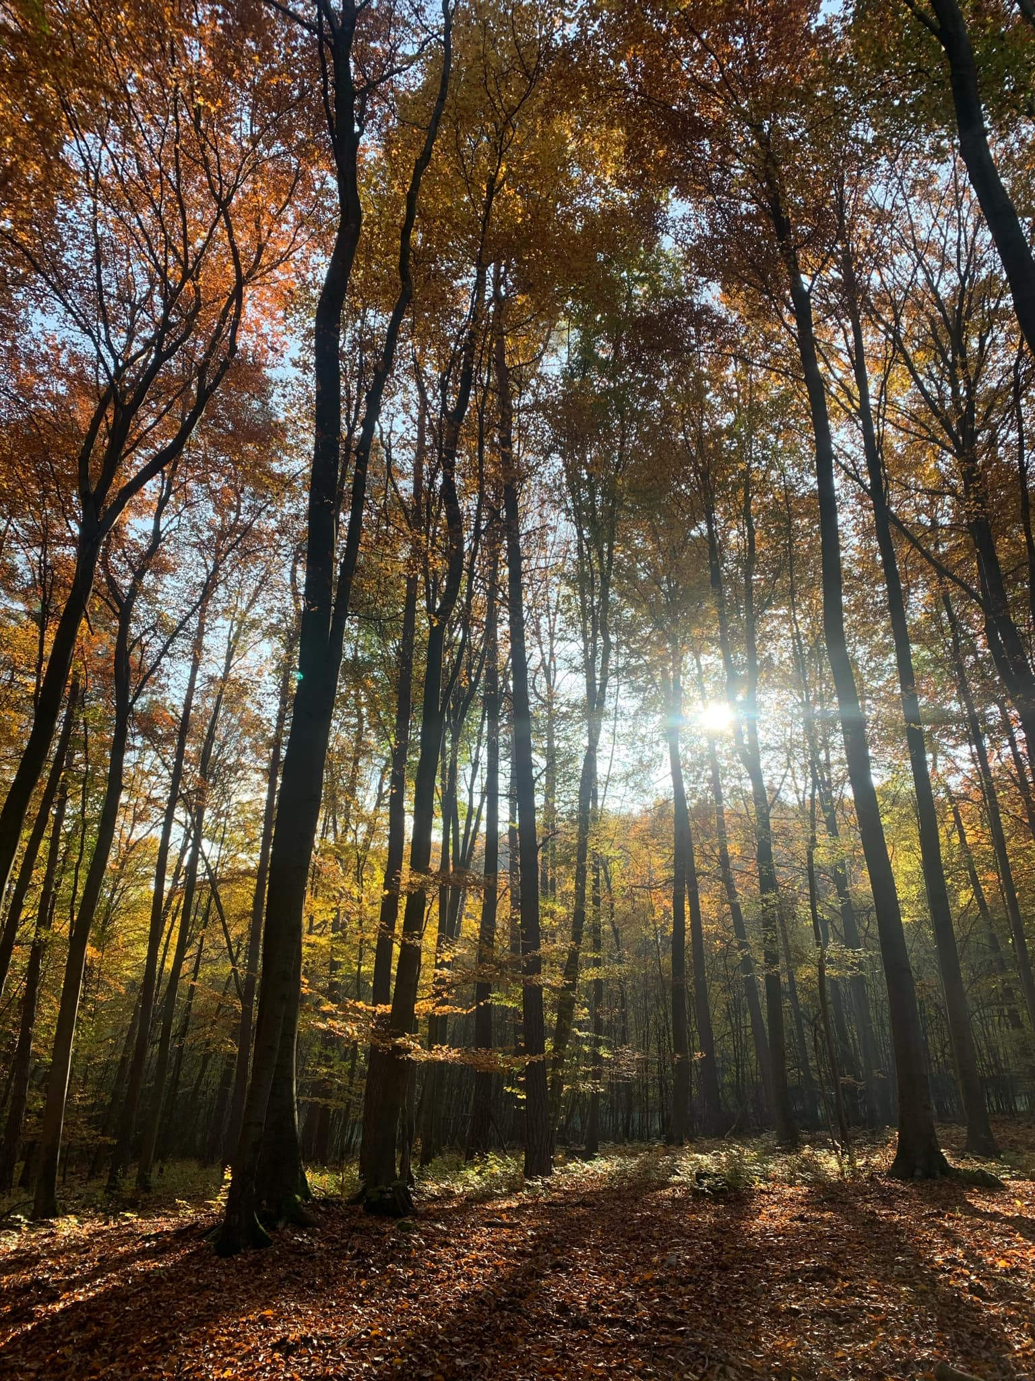
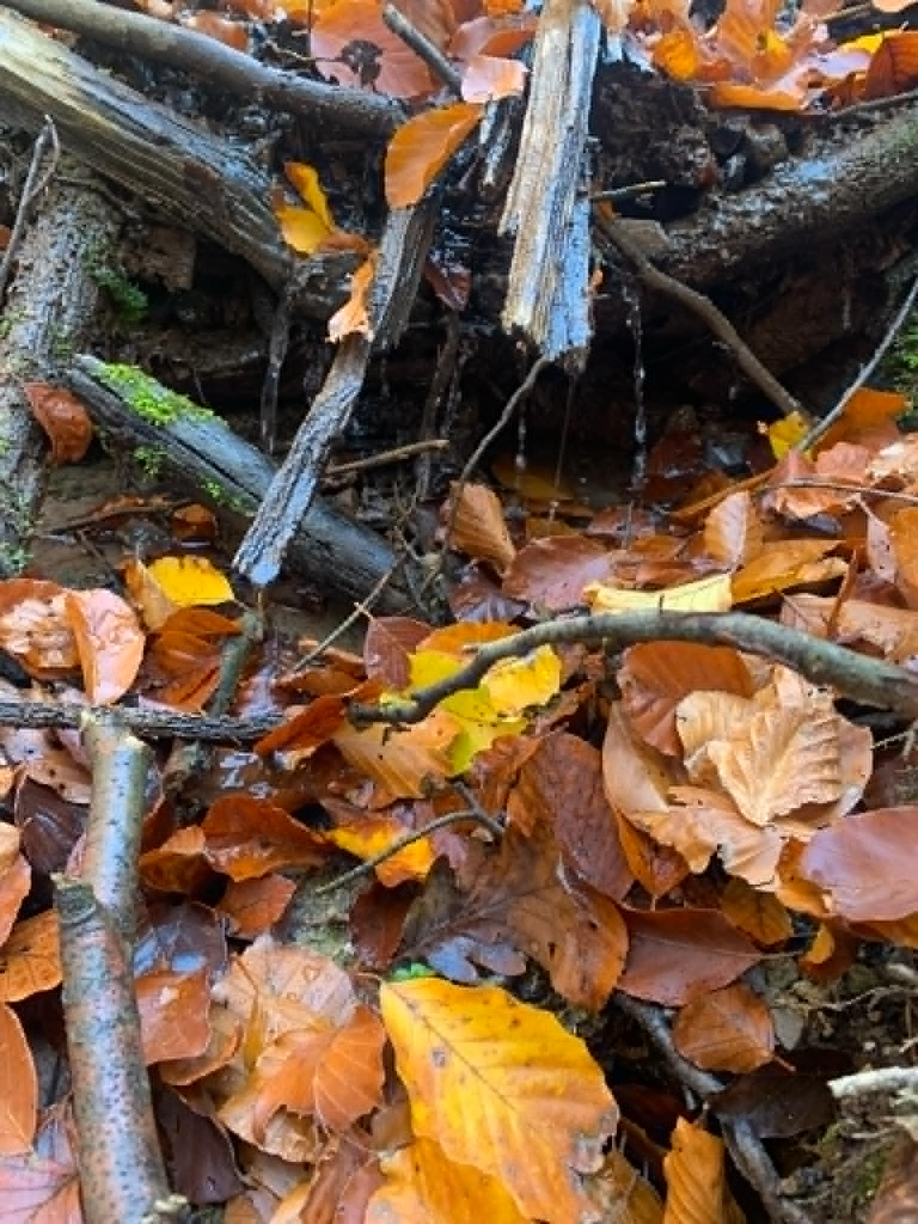
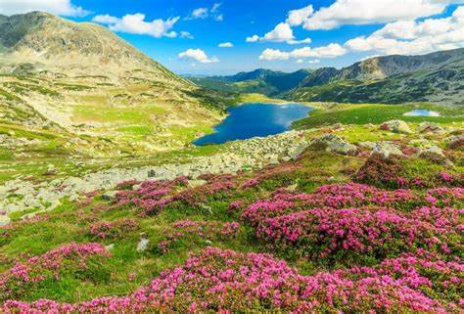
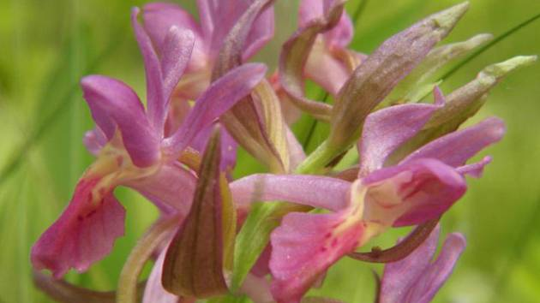
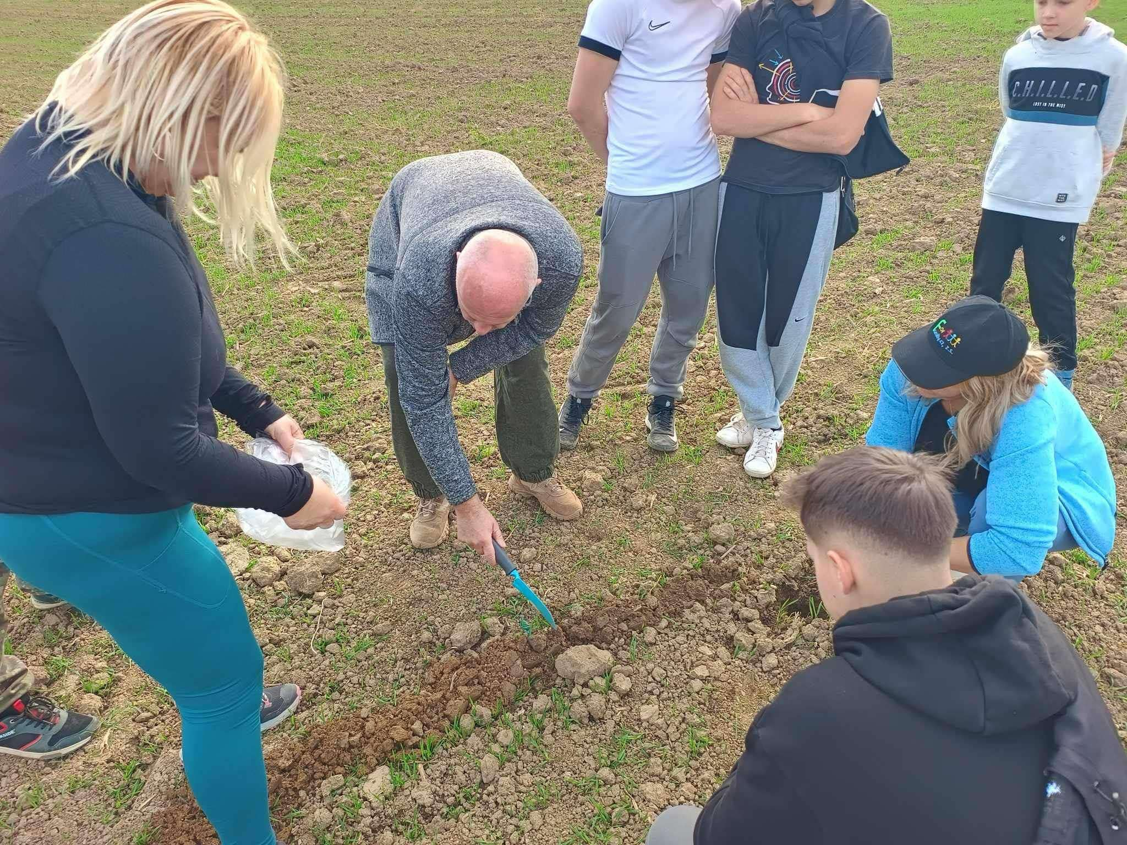
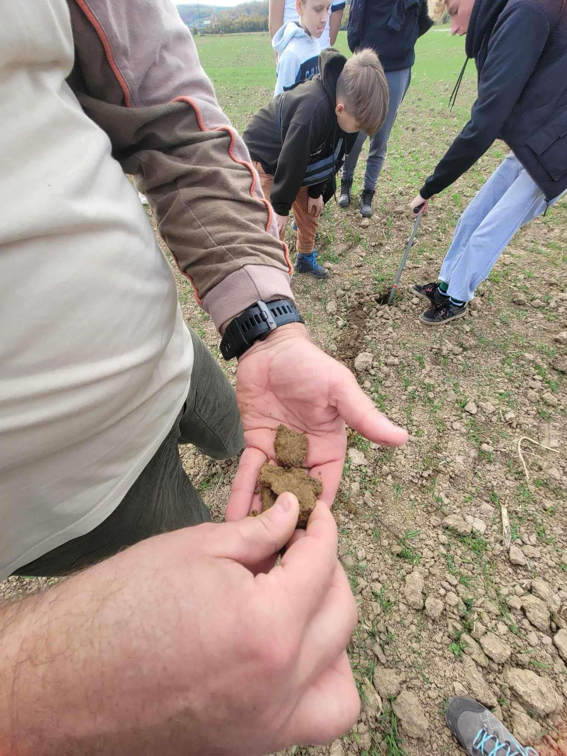
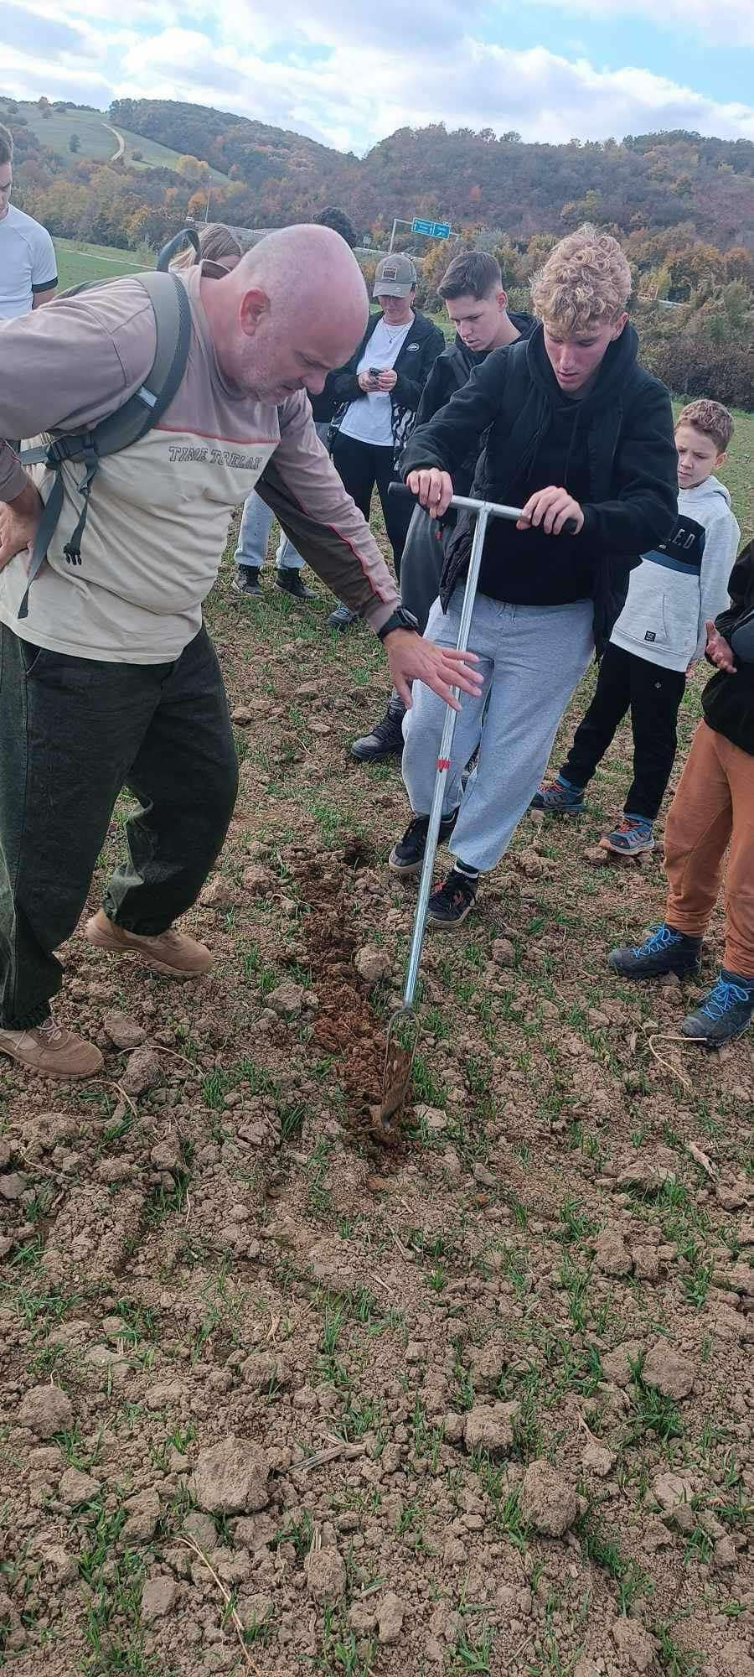
Podla toho ako sa ďelia?
How are they grouped?
Vlastnosti
Proprieties
0brázky - Photos
Vlastnosti pôdy sú výsledkom procesov tvorby pôdy na pozadí určitého podložia, podnebia a pôsobenia organizmov. Horná vrstva pôdy je najviac ovplyvnená účinkami vegetácie.
Soil properties are the result of soil formation processes against a backdrop of specific parent material, climate, and the influence of organisms. The upper layer of soil is most affected by the effects of vegetation.
Slovenské Karpaty
Velke karpaty
Male karpaty
Biele karpaty
Rumunské Karpaty
Carpații Occidentali
Carpații Orientali
Carpații Meridionali

Slide 9


Slide 10
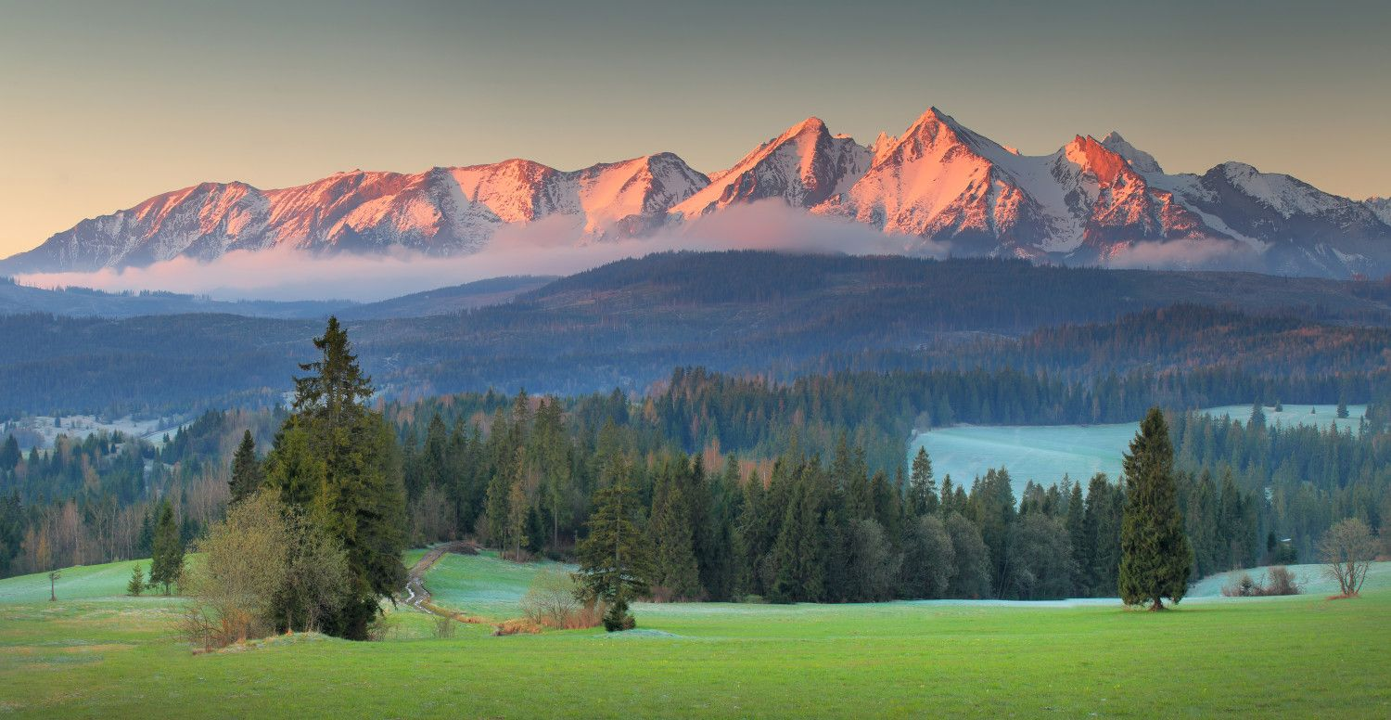
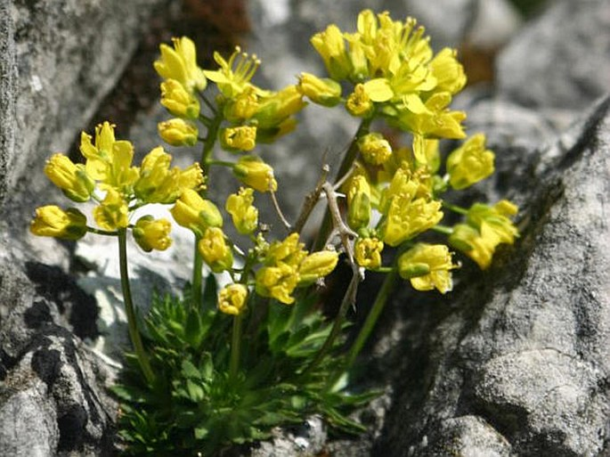
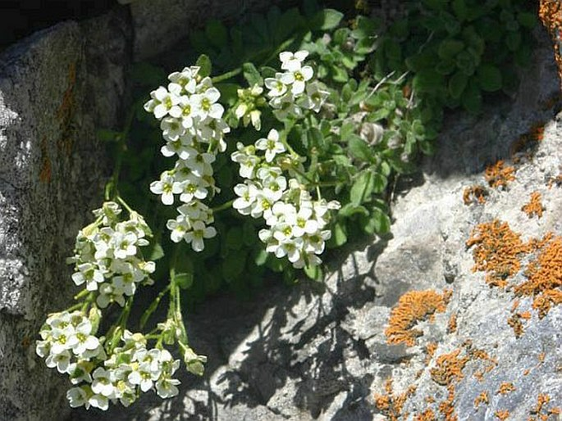
Rastliny, kríky a stromy v Karpatoch
Plants, shrubs, and trees in the Carpathians.
Orhideea
Rhododendron

Slide 11

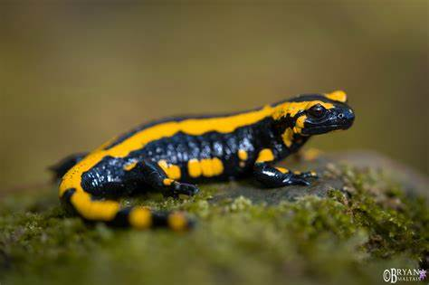
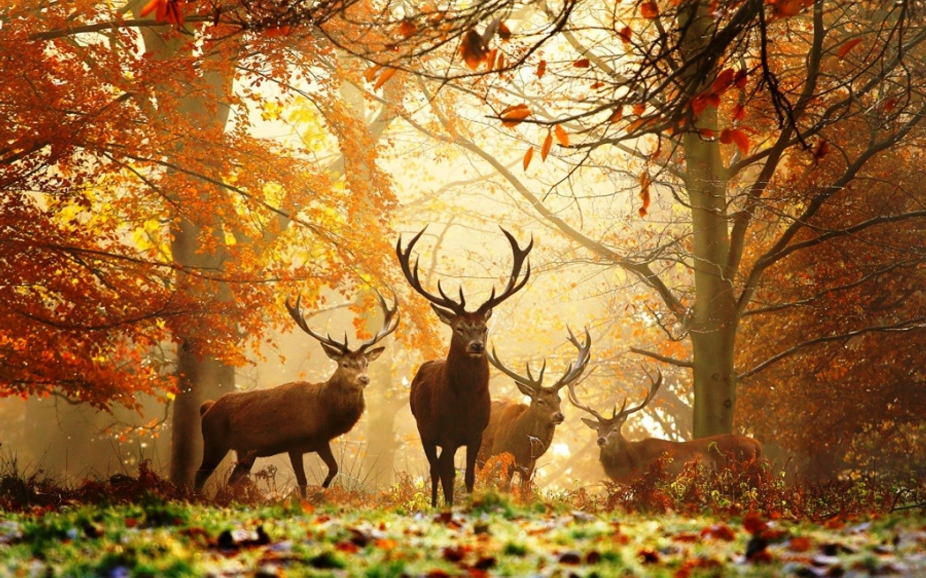
Animals
Salamandra
Zvierata
Plants, shrubs and trees in the Carpathians
Rastliny, kríky a stromy v Karpatoch
Plants, shrubs, and trees in the Carpathians.
Salamander
The term "animal" typically refers either to any living creature or to animals at a higher level of development (such as vertebrates), excluding humans. From a philosophical perspective, an animal is usually defined as a living being that is neither a human nor a deity, mythological figure, supernatural entity, or similar.
Zvieratko je zvyčajne označením buď pre akéhokoľvek živočícha, alebo pre živočíchy na vyššom stupni vývoja (napríklad iba stavovce), s výnimkou človeka. Z filozofického hľadiska sa ako zviera obvykle označuje živá bytosť, ktorá nie je ani človekom, ani božstvom, mytologickou postavou, nadprirodzenou bytosťou a podobne.
The term "animal" typically refers either to any living creature or to animals at a higher level of development (such as vertebrates), excluding humans. From a philosophical perspective, an animal is usually defined as a living being that is neither a human nor a deity, mythological figure, supernatural entity, or similar.
Orhideea
Draba Aizoides - chudoba vzdyzelená
Draba Aizoides - chudoba vzdyzelená
Rhododendron

Slide 12
Zvierata
The Animals
Zvieratko je zvyčajne označením buď pre akéhokoľvek živočícha, alebo pre živočíchy na vyššom stupni vývoja (napríklad iba stavovce), s výnimkou človeka. Z filozofického hľadiska sa ako zviera obvykle označuje živá bytosť, ktorá nie je ani človekom, ani božstvom, mytologickou postavou, nadprirodzenou bytosťou a podobne.
The term "animal" typically refers either to any living creature or to animals at a higher level of development (such as vertebrates), excluding humans. From a philosophical perspective, an animal is usually defined as a living being that is neither a human nor a deity, mythological figure, supernatural entity, or similar.

Slide 13
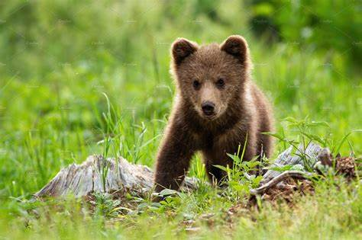
Brown bear
Salamandra
Salamander
Ursul brun
These bears inhabit various biotopes, from dense forests to mountainous areas. They prefer areas rich in food where they can move freely and search for nourishment.
Diet: Brown bears are omnivores, and their diet consists of plants, berries, nuts, insects, and meat. In the summer months, they often feed on fruits and other plant sources, while in winter, they look for food in the form of animal carcasses.
Salamandry sa zvyčajne vyskytujú vo vlhkom prostredí, ako sú lesy, mokrade alebo okolo vodných tokov. Potrebujú vlhkosť, aby udržali svoju pokožku v dobrom stave.
Salamanders typically inhabit moist environments, such as forests, wetlands, or around water bodies. They need humidity to keep their skin in good condition.
These bears inhabit various biotopes, from dense forests to mountainous areas. They prefer areas rich in food where they can move freely and search for nourishment.
Diet: Brown bears are omnivores, and their diet consists of plants, berries, nuts, insects, and meat. In the summer months, they often feed on fruits and other plant sources, while in winter, they look for food in the form of animal carcasses.

Slide 14
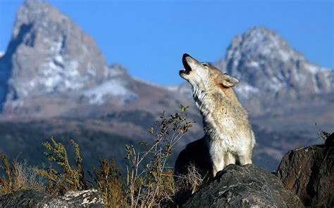
Salamandra
Salamander
Ursul brun
The Brown bear
Wolf
Acești urși trăiesc în diferite biotopuri, de la păduri dense până la zone montane. Preferă zone bogate în hrană, unde se pot mișca liber și căuta hrană.
Dieta: Urșii brun sunt omnivori, iar dieta lor se compune din plante, fructe de pădure, nuci, insecte și carne. În lunile de vară, se hrănesc adesea cu fructe și alte surse vegetale, în timp ce iarna caută hrană sub formă de cadavre de animale.
These bears inhabit various biotopes, from dense forests to mountainous areas. They prefer areas rich in food where they can move freely and search for nourishment.
Diet: The brown bears are omnivores, and their diet consists of plants, berries, nuts, insects, and meat. In the summer months, they often feed on fruits and other plant sources, while in winter, they look for food in the form of animal carcasses.
Vlk je predátor a jeho strava sa skladá prevažne z veľkých bylinožravcov, ako sú jelene a diviaky, ale môže sa živiť aj menšími zvieratami a ovocím.
Ohrozenie: Vlk je ohrozený v niektorých oblastiach v dôsledku straty biotopu, lovu a prebiehajúcich konfliktov s ľuďmi. Ochrana vlkov je predmetom mnohých ochranárskych iniciatív.
The wolf is a predator, and its diet primarily consists of large herbivores, such as deer and wild boar, but it can also feed on smaller animals and fruit.
Threats: Wolves are endangered in some areas due to habitat loss, hunting, and ongoing conflicts with humans. The protection of wolves is the focus of many conservation initiatives.

Slide 15
Vlk
The wolf
Vlk je predátor a jeho strava sa skladá prevažne z veľkých bylinožravcov, ako sú jelene a diviaky, ale môže sa živiť aj menšími zvieratami a ovocím.
Ohrozenie: Vlk je ohrozený v niektorých oblastiach v dôsledku straty biotopu, lovu a prebiehajúcich konfliktov s ľuďmi. Ochrana vlkov je predmetom mnohých ochranárskych iniciatív.
The wolf is a predator, and its diet primarily consists of large herbivores, such as deer and wild boars, but it can also feed on smaller animals and fruit.
Threats: The wolves are endangered in some areas due to the habitat loss, hunting, and ongoing conflicts with humans. The protection of wolves is the focus of many conservation initiatives.

Slide 16
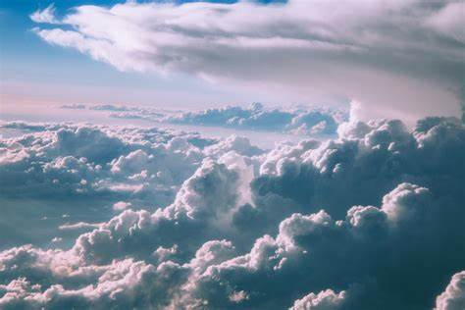
Plants, shrubs and trees in the Carpathians
Rastliny, kríky a stromy v Karpatoch
Plants, shrubs, and trees in the Carpathians.
Vzduch
The aer
Draba Aizoides - chudoba vzdyzelená
Draba Aizoides - chudoba vzdyzelená
Orhideea
Vzduch je zmesou plynov bez farby a zápachu. Zem obklopuje asi 100 kilometrov vysoká vrstva vzduchu
V SVK,RUM,HUN= je bez viacerých probémov bez narusenia chemikaliami a narusenia ropovodmy a
Rhododendron
The air is a mixture of colourless and odourless gases. The Earth is surrounded by a layer of air about 100 kilometers high.
1

Slide 17

Vzduch
Aer
DAKUJEME ZA POZORNOST
Vzduch je zmesou plynov bez farby a zápachu. Zem obklopuje asi 100 kilometrov vysoká vrstva vzduchu
V SVK,RUM,HUN= je bez viacerých probémov bez narusenia chemikaliami a narusenia ropovodmy a
Air is a mixture of colourless and odourless gases. The Earth is surrounded by a layer of air about 100 kilometers high.
1

Slide 18


